Slide 1
Testmug
Superpowers to manual testers

Slide 2
Current Automation solved execution speed. Nobody solved test design labor.
The Problem:
The real bottleneck? Not execution. Design.
Who cares:
Enterprises pour $20-30B annually into manual testing—56% of all testing spend

Slide 3
85% of testing requires human judgment and never goes away. Instead of fighting that reality, we amplify manual testers with AI
Insight:
Why Now:
Lovable/Bolt proved “describe intent → AI builds it” works for non-coders

Slide 4
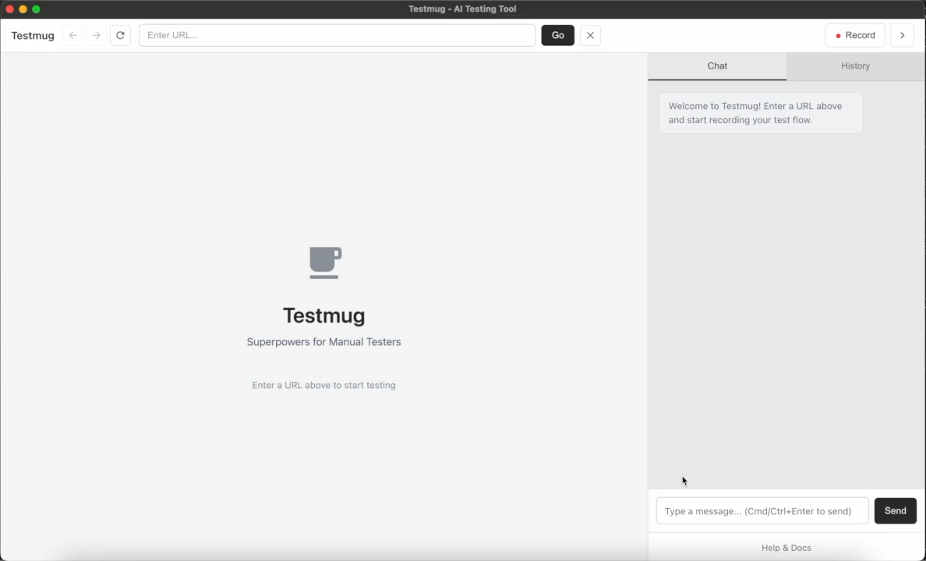
Solution Demo

Slide 5
Tech Architecture (Models, Data, Stack)
Frontend
React 18 + TypeScript
Vite (fast build tool)
Desktop Framework
Electron (cross-platform desktop app)
BrowserView (embedded Chromium for recording)
AI & Testing
OpenAI GPT-4 / Groq API (test generation)
Playwright (test execution engine)
File Generation
ExcelJS (Excel reports)
docx (Word reports with screenshots)
Storage
Local file system (recordings, test cases, results)
SQLite-based session storage

Slide 6
Value & GTM (Who Pays, How to Reach)
QA Managers/Enterprise, freemium-to-paid model.
How to Reach:
Product-led growth → Community marketing → Tool integrations → Enterprise sales.

Slide 7
Roadmap & Risks
Roadmap:
MVP essentials → 20 paid users → Feedback → Generalization → Enterprise scale.
Risks:
AI quality (manual edits), selectors (self-healing), adoption (freemium).

